Slide 1

2024 Labour voters, where are they now & Why
By Dr. James Prentice
Lead Researcher of
Capture Politics
To start the presentation press F5,
then use the space bar proceed.

Slide 2


Method and Assumptions
Data:
Uses the British Election Study (BES) 2025 to isolate people who voted Labour in 2024.
Divides people into how they would vote if a general election was happening now (The survey was conducted Just after the local elections in 2025 – Published in September 2025).
Sample 30,000+ people
Assumptions on the current strategy:
Labour is using the “Blue Labour Strategy” – focusing on wining back working-class voters who have gone to reform.
The strategy intends to heavily focus on immigration – dealing with rising numbers.
The strategy will mainly focus on fighting Reform.
The strategy will use language to appeal to left-authoritarian voters, more so than left-liberal ones.

Slide 3
Core Findings
Losses to the Lib-Dems and Greens are consistently different to losses of Reform.
Left-Liberal and Reform switchers have contrasting opinions on cultural questions.
Labour is losing more voters to Left/Liberal parties (plus not sure) than to Reform.
Current losses represent a continuation of the electoral challenges Labour faced in the last parliament.
Probably easier to win back voters lost to left/liberal parties than Reform. This is due such voters viewing Labour more favourably.
The government’s negative narrative on immigration is likely turning away larger groups of left-liberal voters, and not winning over individuals moving from Labour to Reform.
Labour is generally losing support due to a lack of confidence in their ability to handle key issues (The economy and Immigration). Concerns with competence in government is a major theme.
Another core cause of losses has resulted from individuals viewing the Labour brand negatively.
The findings raise difficult questions on whether the Blue Labour “chasing reform” strategy is the most optimal one.
Forming a progressive coalition probably the most optimal strategy.

Slide 4
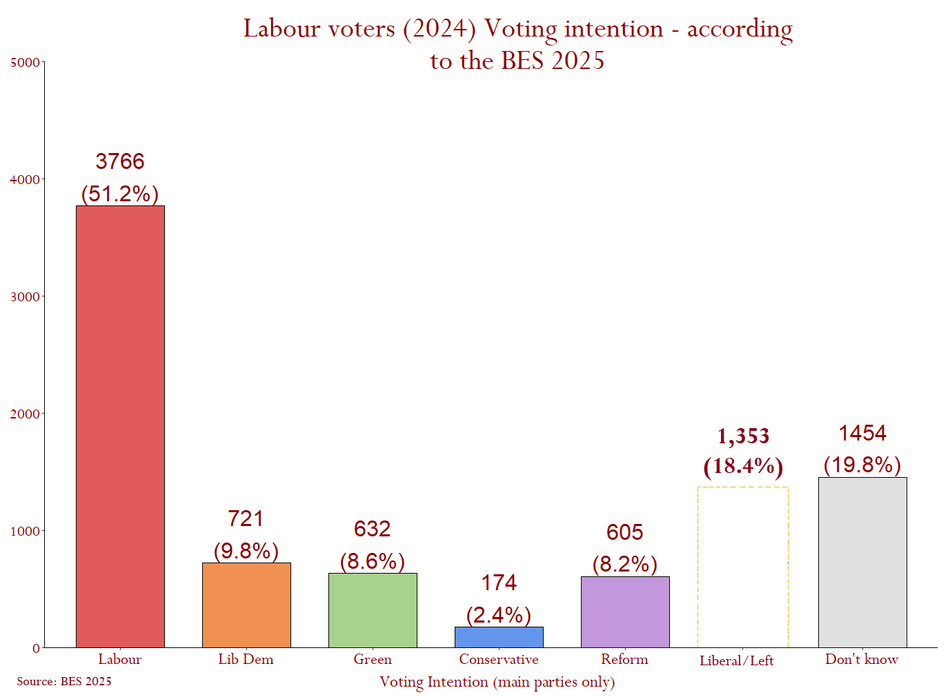
Summary (2) - Support for Labour and where it has gone
Now, Labour is on 22% of the vote - 10% behind Reform.
The Greens and Lib-Dems combined are on 25% (most are Lib-Dem).
Labour have mostly lost 2024 support to the Greens and Lib-Dems (18%) and Not sure’s – (20%).
Losses to Reform only = 8% of Labour’s 2024 vote. Losses to Left-Liberals is far greater.
12.8% - of all voters
Only 2.7% - of all voters
78% of all losses!
Only 17% of all losses!
1.8m
voters
1.9m
voters
0.8m
voters
Note: These figures only include people who voted in 2024.

Slide 5
Who are They?

Slide 6
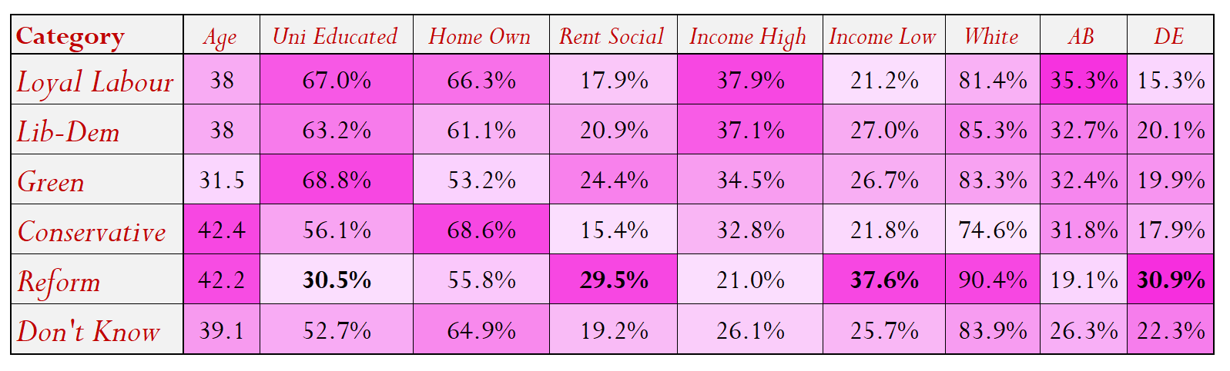
Lib-Dem & Green losses reflect the party’s base.
They tend to be:
- Younger.
- Own property.
- On higher income.
- More ethnically diverse.
- Professional classes.
Reform switchers are consistently different.
They tend to be:
- Older.
- Socially rent.
- On a low income.
- White British.
- Be working-class.

Slide 7
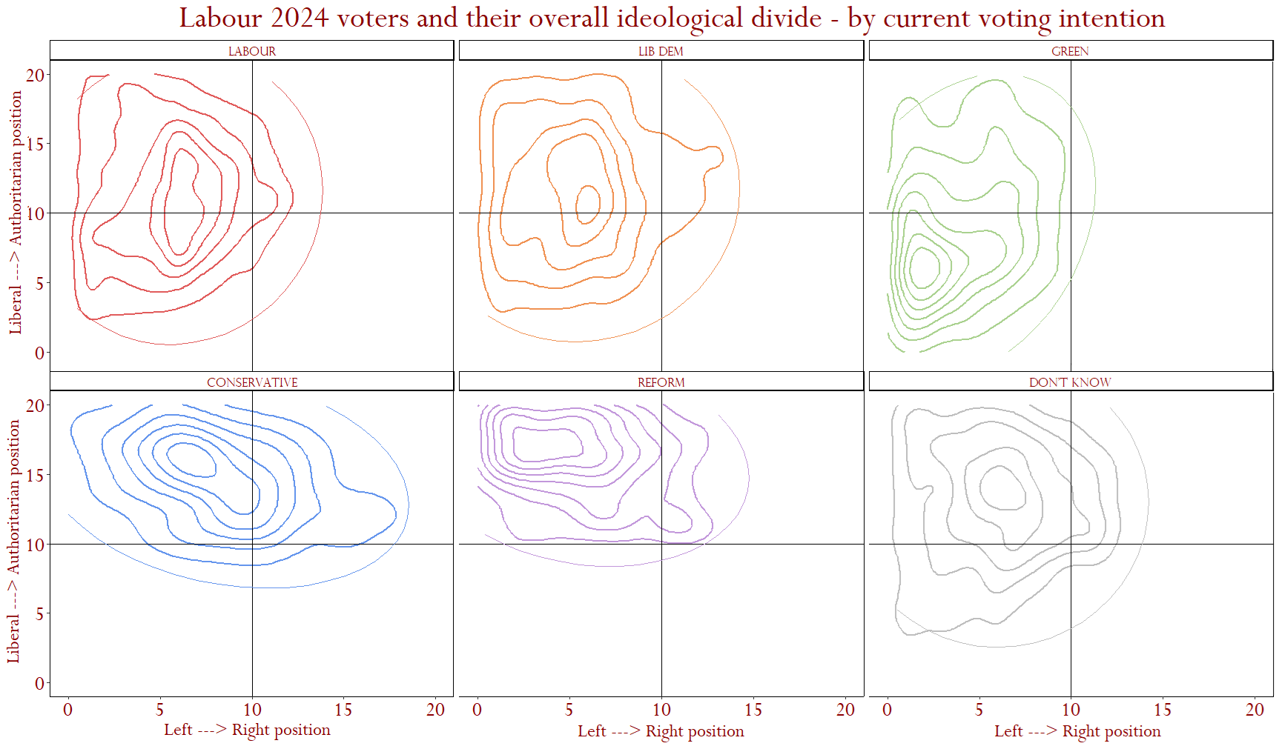
There are clear ideological divisions:
Reform losses are left–Authoritarian
The losses to Greens are Left-Liberal
Lib-Dem switchers are centre and mostly liberal

Slide 8
Their Priorities

Slide 9
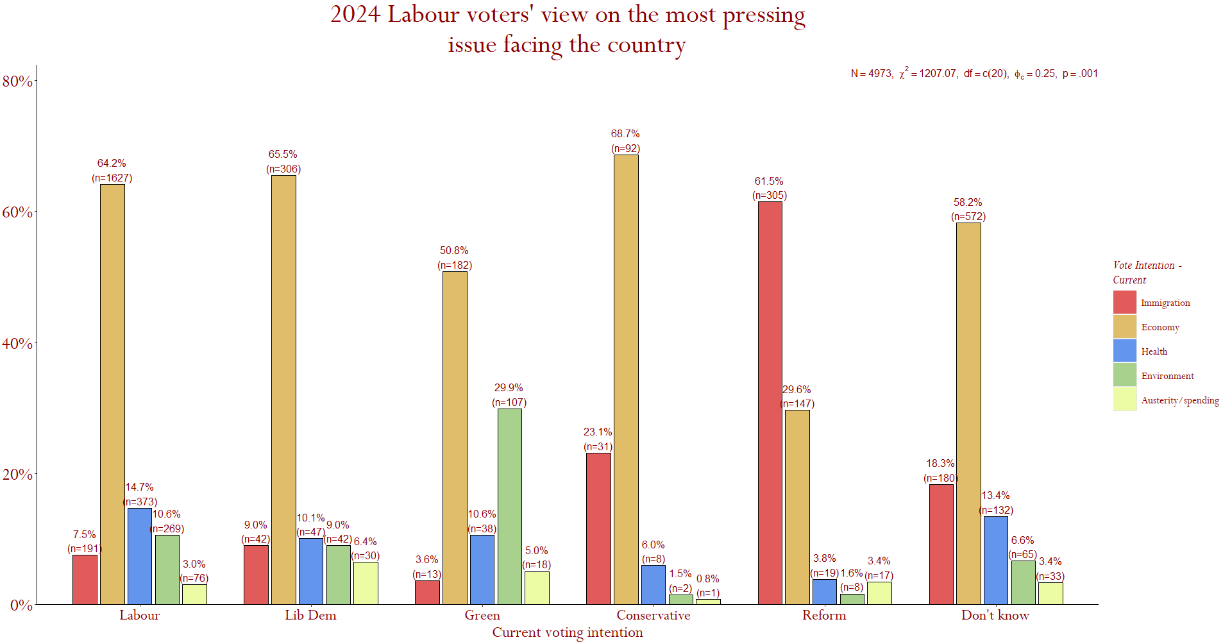
Biggest Concern:
Source: BES 2025.
Improving the economy is a wining strategy!
This suggests a focus on migration is not a wining strategy!
Economy: Still Labour, Lib-Dem,
Green, Tory, Don’t Knows.
Immigration: Only Reform, but 30% still focus on the Economy.

Slide 10
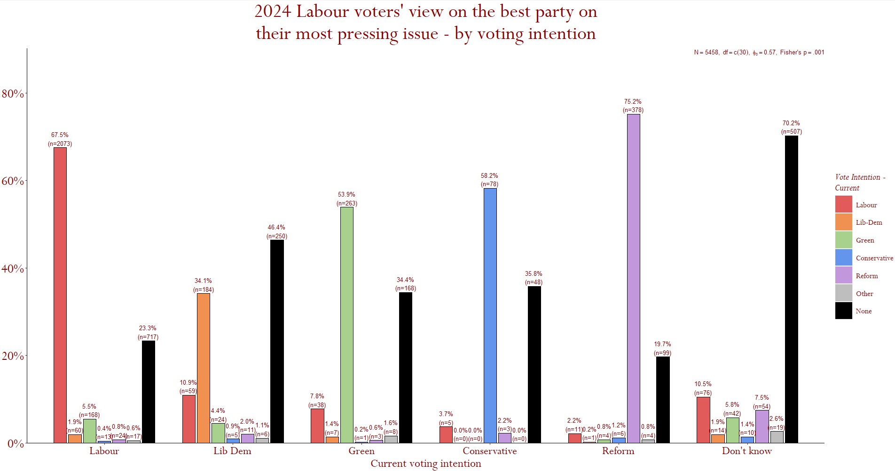
Ability on core issue
Source: BES 2025.
Prefer Reform on immigration
Labour losing economic credibility has given Lib-Dems & Greens gains.
Labour has kept those who believe it can deliver on their core concerns
Other parties secure Labour support when they are more trusted on core concerns.
Don’t Knows feel no party can address their top issue.

Slide 11
Opinions on the Economy & Public Services

Slide 12
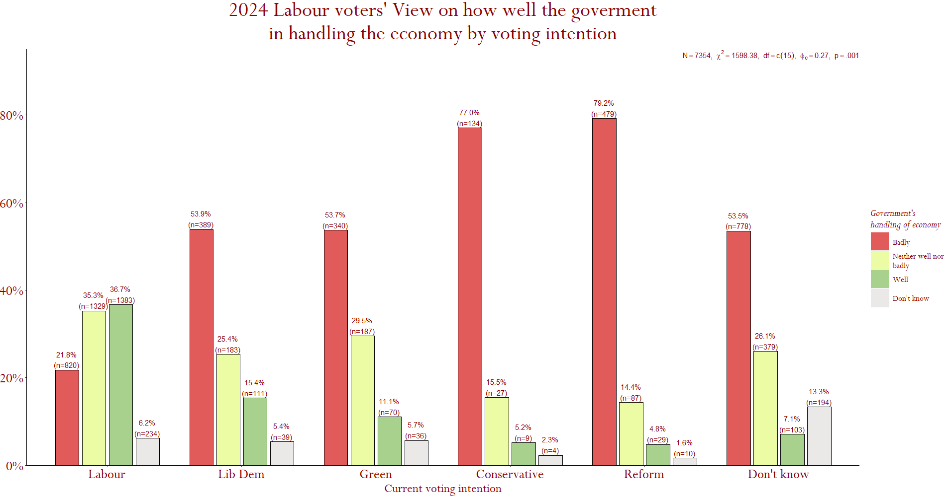
Economic Competence:
Source: BES 2025.
All losses also report feeling financially worse off in the last year
Don’t knows feel the same, but are unsure who can do better
72% feel Labour has done poorly on economic management
Labour has kept those that feel they can deliver
A majority of lost support don’t feel the government is doing a good job handling the economy
Reform & the Tories most often feel this, meaning they could be harder to win over.

Slide 13
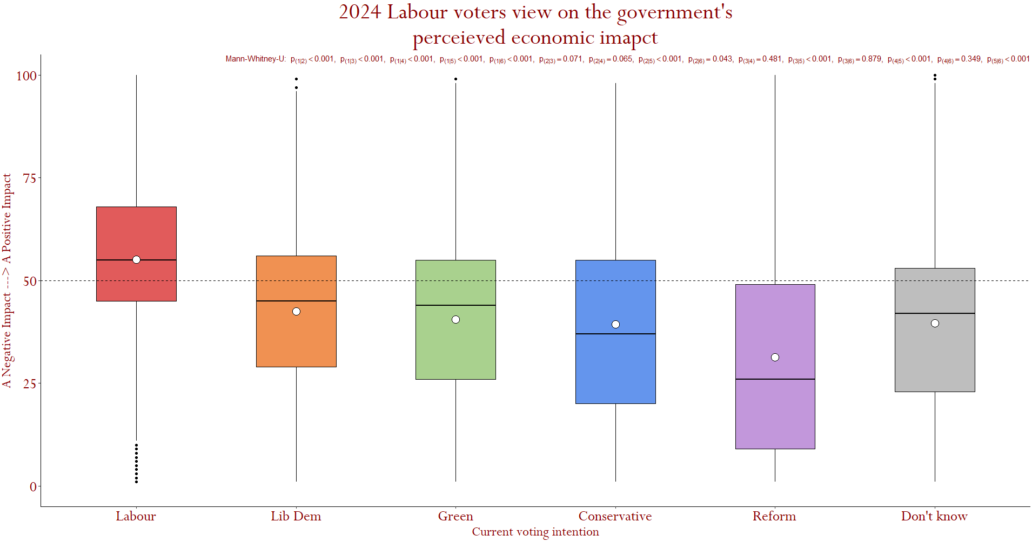
Labour’s impact on the Economy:
Source: BES 2025.
Nearly 75% of those still with Labour supporters feel Labour is improving the economy
A majority of losses feel the government has worsened the economy
Reform losses are most pessimistic about the government’s impact

Slide 14
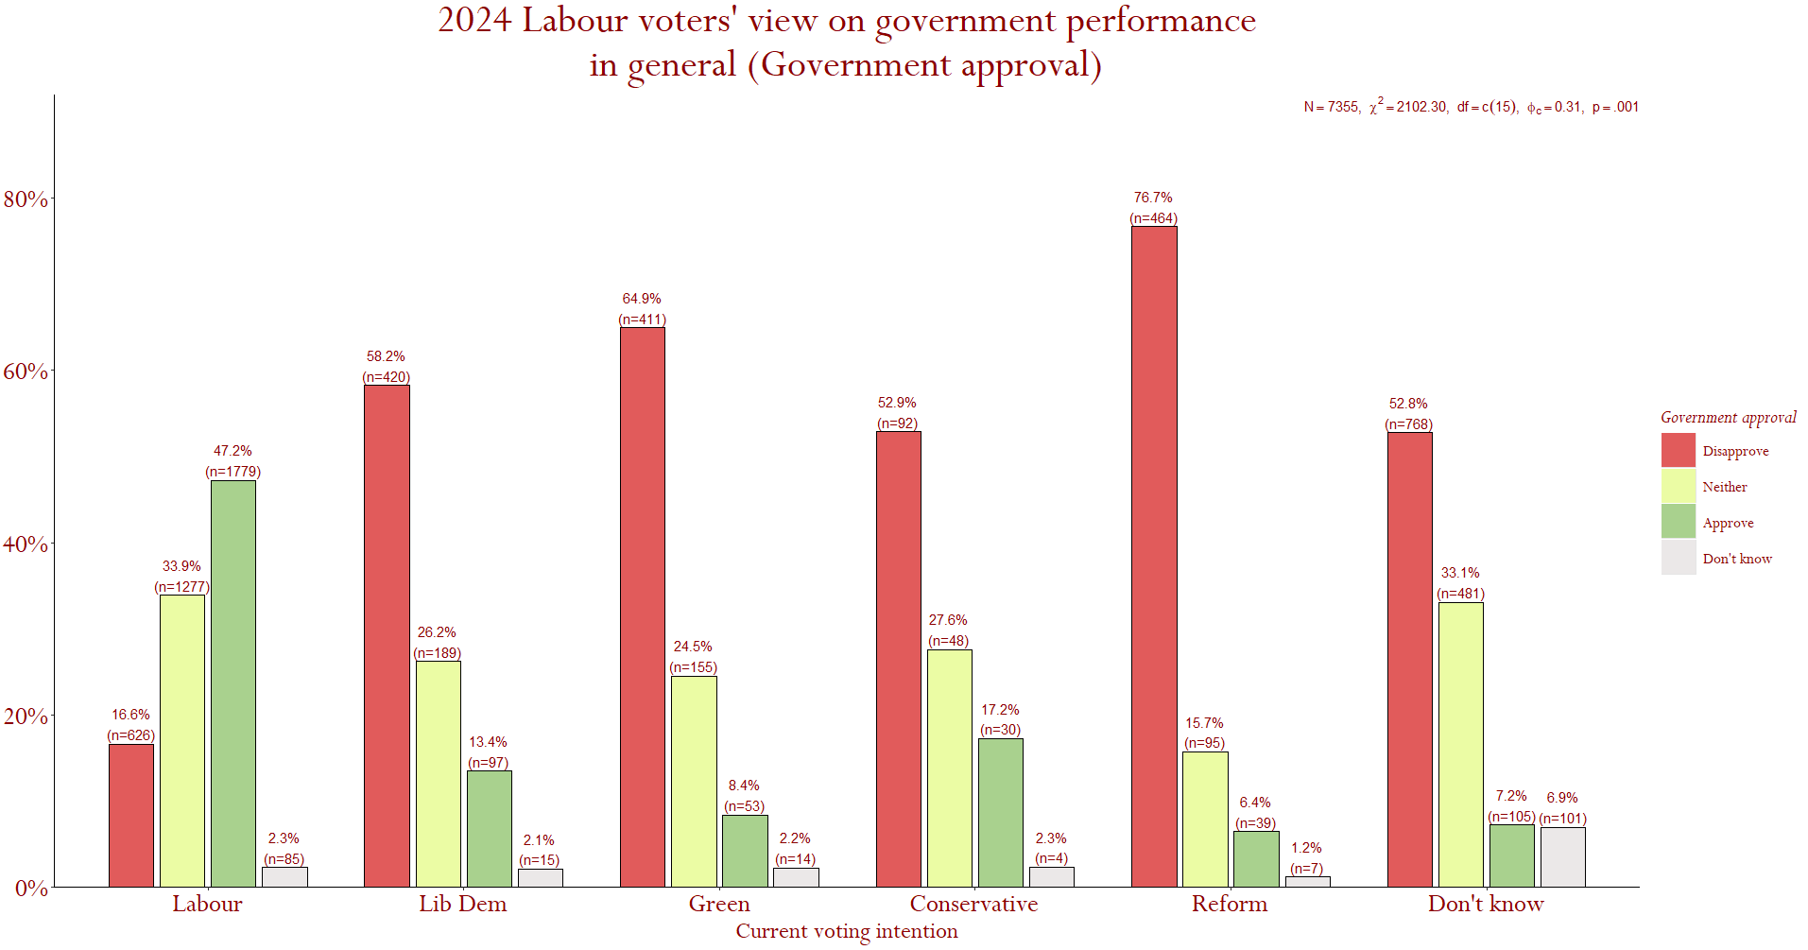
Government competence
Source: BES 2025.
The voters kept mostly (81%) do not disapprove of the government’s performance.
Reform losses are the most frequently disillusioned
*
A majority of voters Labour have lost disapprove of government performance so far. This indicates wide concerns about competence.
*
*
*
*
The voters Labour have lost view the party as performing poorly on a rage of issues, the economy, NHS, education and crime – this indicates wider performance concerns.

Slide 15
Opinions on Immigration

Slide 16
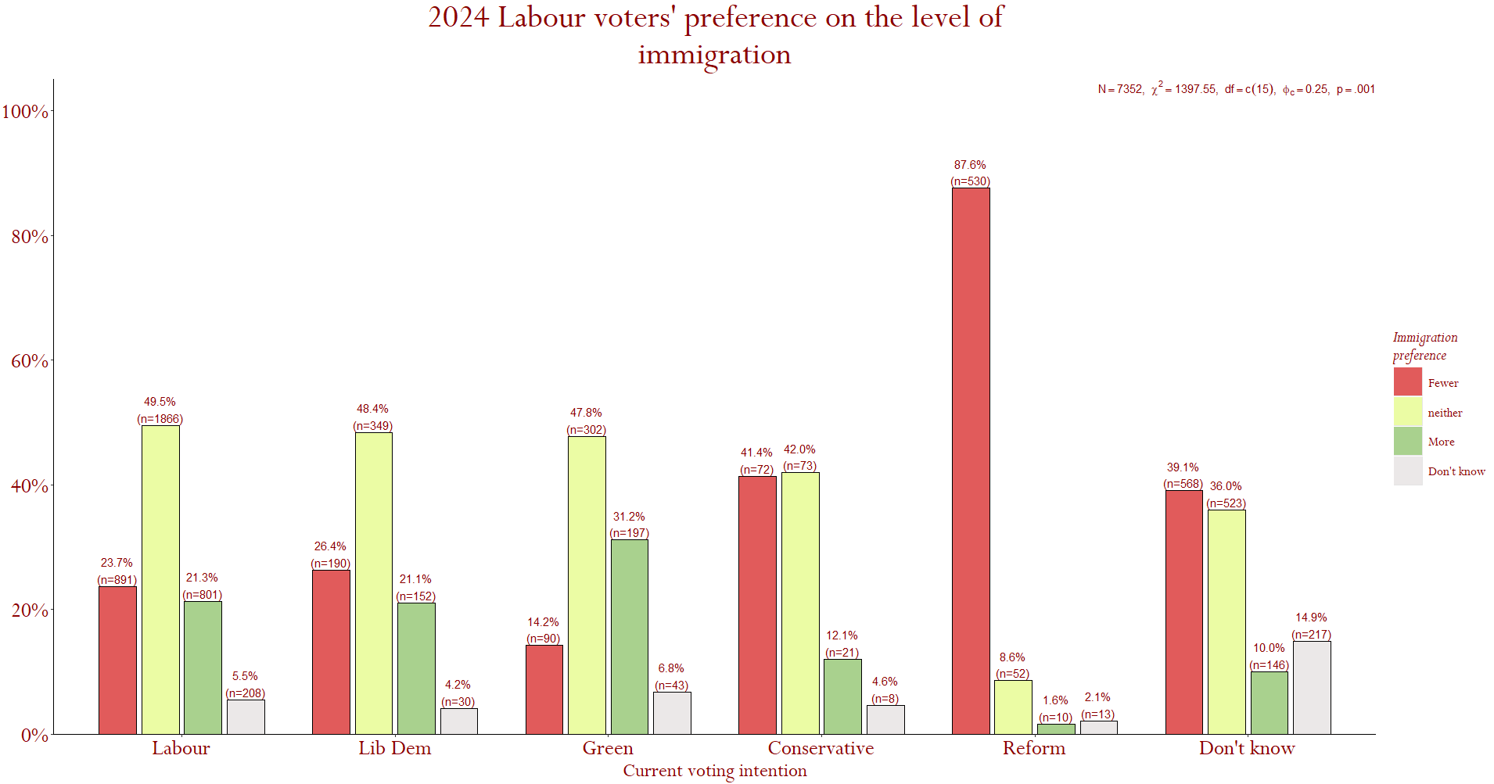
Migration Preference:
Source: BES 2025.
A majority (71%) supporting Labour will accept current levels
Most losses are indifferent or would accept more.
Reductions in migration only Preferred by those moving to Reform.
A majority (62%) of those who have left for the Lib-Dem, Greens & Tories + those not sure would accept current migration levels

Slide 17
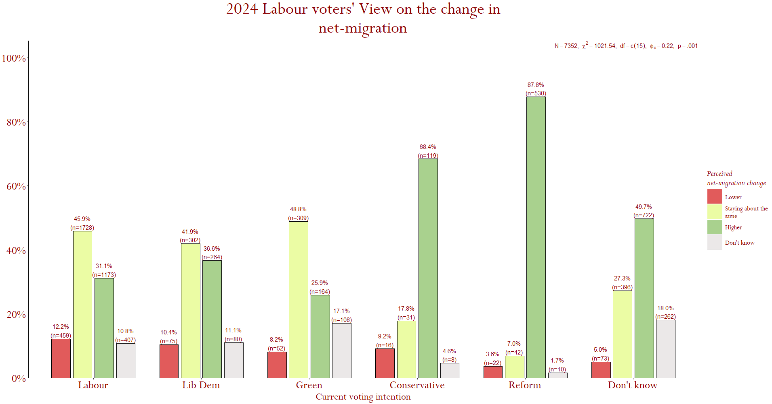
Perception of Migration:
Source: BES 2025.
A majority of Reform and Conservative switchers perceive net-migration to be increasing (when it is decreasing)
Far fewer see the government as increasing migration – going harder on migration may upset those who are comfortable with current migration levels
There is no guarantee they will believe Labour even if reductions are achieved due to such perceptions
Therefore, there may be no reward on focusing on reducing migration
But it may Repel voters lost to LDs & Greens

Slide 18
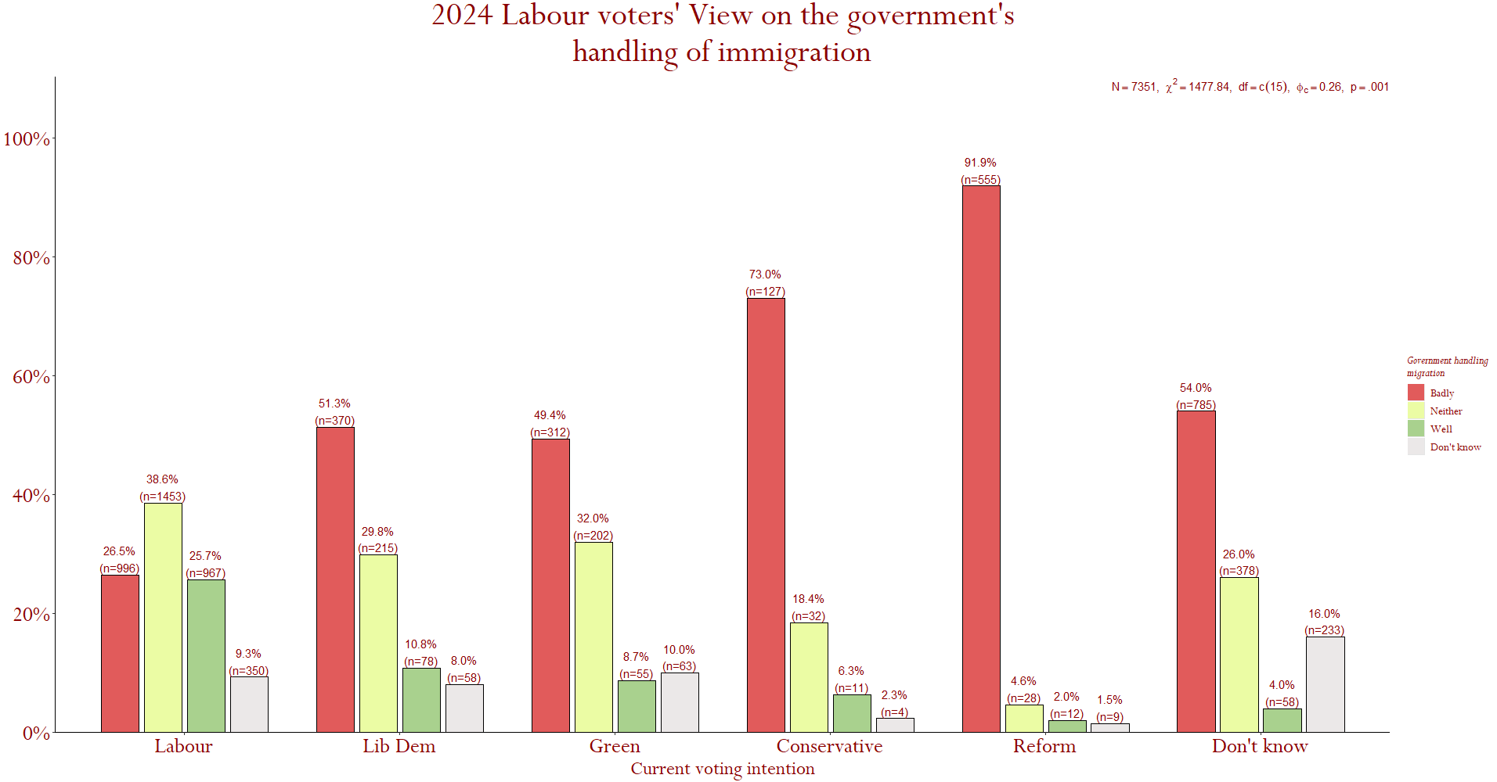
Handling Migration:
Source: BES 2025.
*
Reform voters least often feel Labour is handling the issue well. 90% see Labour unfavourably on the issue
*
*
*
*
Those who have stuck with Labour view Labour’s ability to handle migration more positively than losses
A majority of all losses see Labour as unable to handle migration
Reform switchers most often see Labour as unable to handle immigration

Slide 19
Opinions on Europe & Abroad

Slide 20
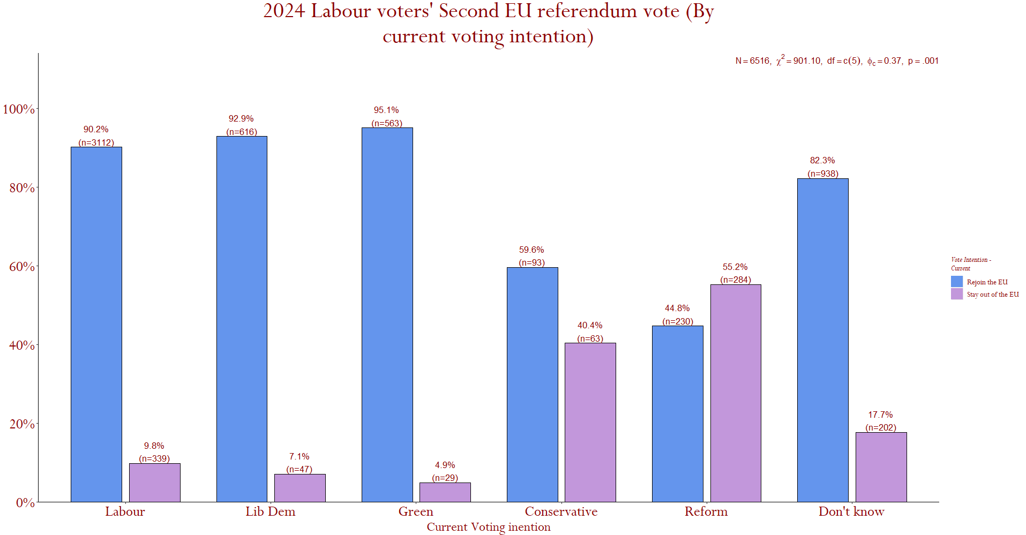
Re-joining the EU?
Source: BES 2025.
*
*
*
*
Only those Labour lost to Reform would stay out
Most Labour voters who have left voted to Remain and would vote to Rejoin, Over 80% for Lib-Dem & Greens + those unsure.
82% of losses to the Greens and Lib-Dems want closer ties on Europe – only 21% Reform voters do

Slide 21
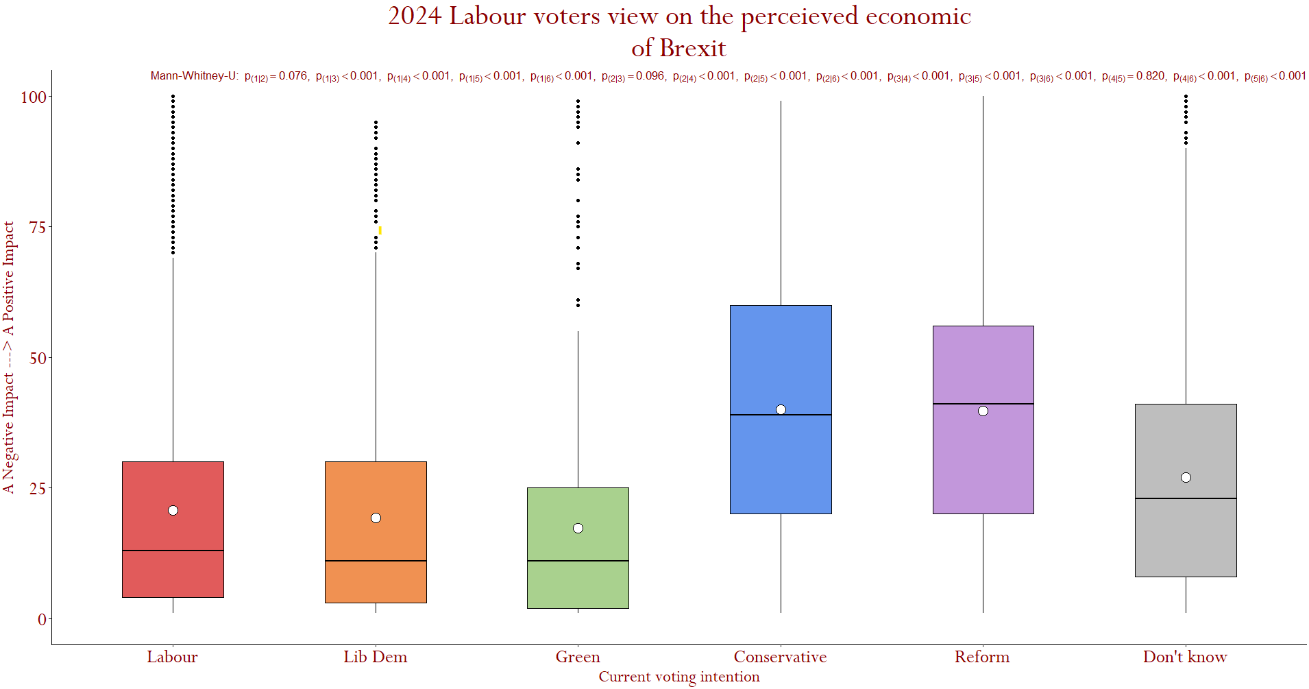
Economic impact of Brexit?
Source: BES 2025.
Most voters fall under this line, A negative view.
A majority feel Brexit has had a negative economic impact, regardless the party they have switched to.
Labour’s EU position unlikely to lead to losses
Closer economic ties with Europe may be popular

Slide 22
Main Causes of Losses

Slide 23
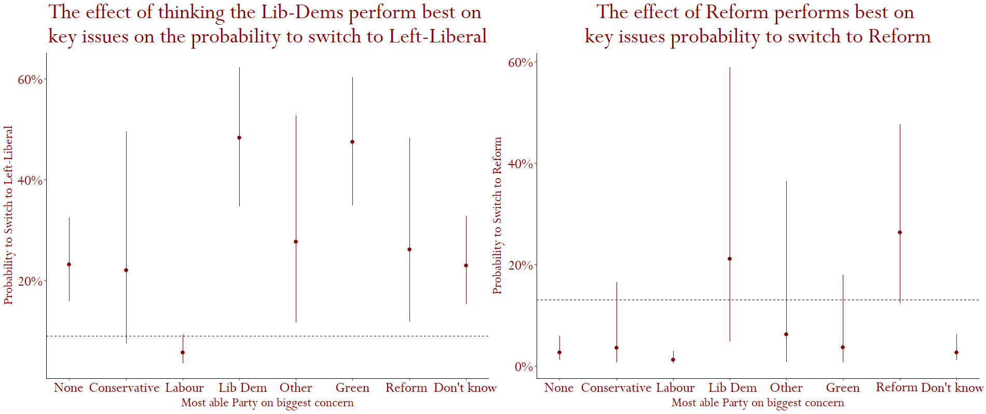
Main causes (1 – Performance on Core issues)
Perceiving the Lib-Dems/Greens as the best party on core concerns
Perceiving Reform as the best party on core concerns
21% more likely to Switch to Reform
=
43% more likely to Switch to Lib -Dems/ Greens
=

Slide 24
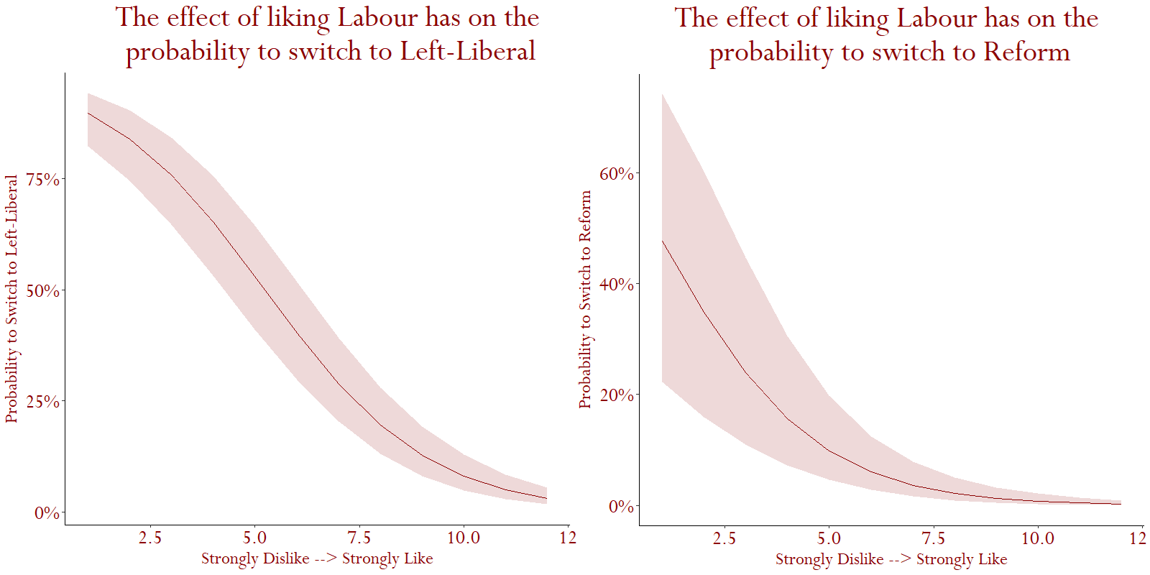
Main causes (2 – A damaged party brand?)
Liking Reform and disliking Labour – strong chance of switching parties.
Liking Left-liberals and disliking Labour – strong chance of switching parties.
Strongly Liking Labour
Strongly Liking Labour
=
82% less likely to Switch to a Left-Liberal Party
=
47% less likely to Switch to Reform

Slide 25
Voting History & Future

Slide 26
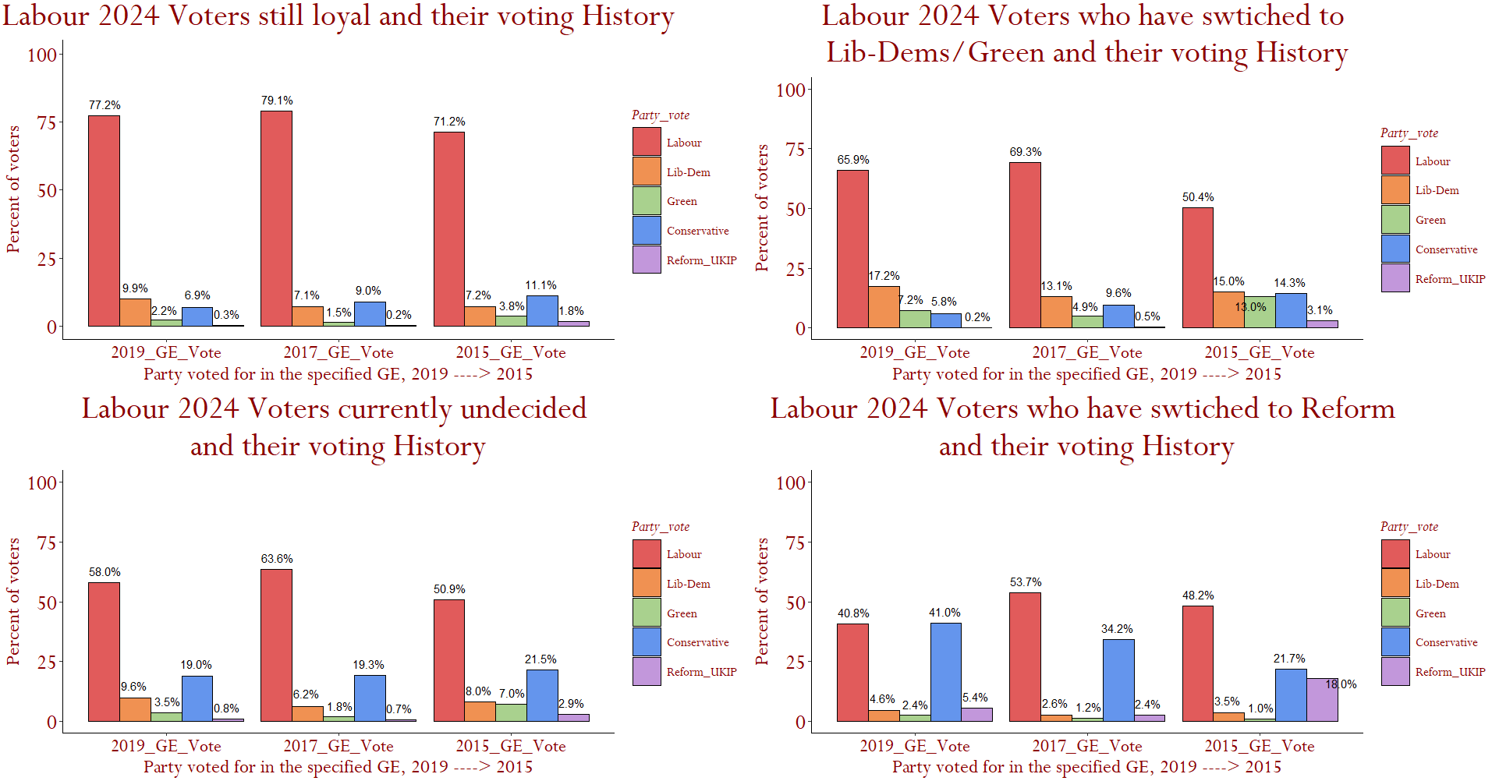
Lib-Dem & Green switchers have voted Labour more frequently in the last 10 years than Reform switchers
Easier to win Left-Liberals over than Reform?
Source: BES 2025.
*
*
*
*
!
*
*
!
!

Slide 27
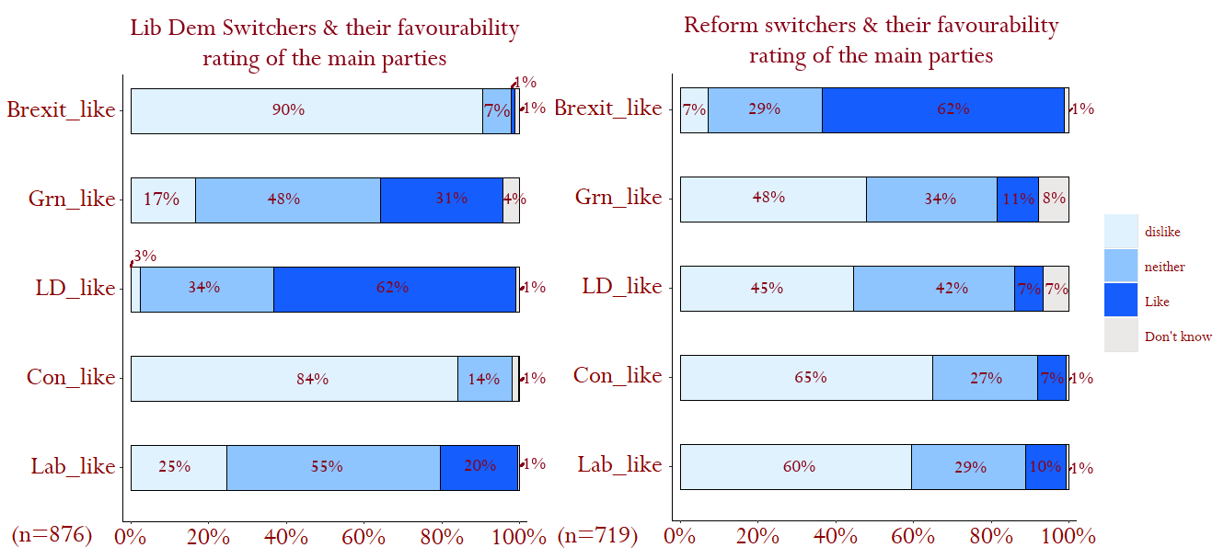
Party
Ratings
Source: BES 2025.
39% lukewarm or like Labour
75% lukewarm or like Labour
*
*
2024 Labour voters switching recognise party brands, more so than leaders
Fewer Lib-Dem & Green switchers Dislike Labour than Reform switchers
More (X2) Lib-Dem & Green losses like Labour than Reform losses

Slide 28
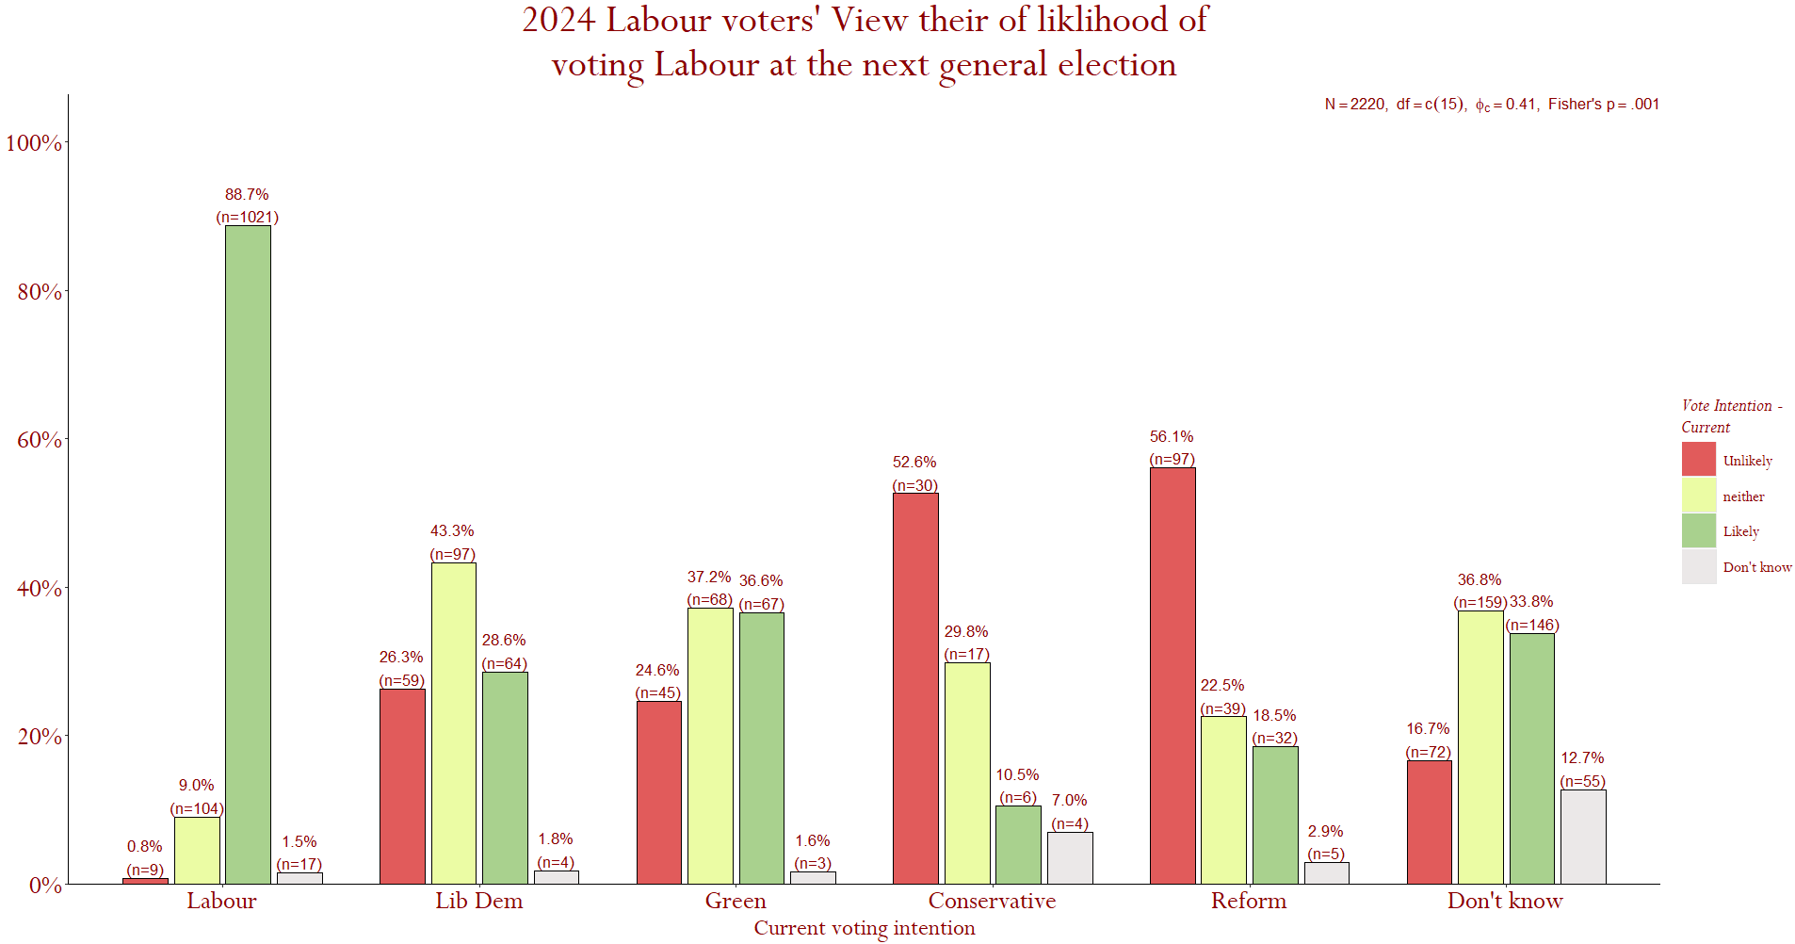
Voters Labour has lost to the Greens/Lib-Dems say they are more likely to come back than those they have lost to Reform.
Perceived likelihood to vote for Labour
Source: BES 2025.
Those still Labour likely to stay
Only 41% say they are very likely or moderately likely to vote Labour at the next election
74% very likely or moderately likely to vote Labour at the next election
72% very likely or moderately likely to vote Labour at the next election
It is 71% for those undecided

Slide 29
A Better Strategy?

Slide 30








A better strategy available?
Building a progressive coalition
Plan
Highlighting the costs of Reform & How Labour is different.
Cost of living and economic narrative
Targeting Left/Liberal voters
Improve comms on govt competence
35%
?
Building a base bigger than Reform’s by securing voters Reform can’t reach
Why target these voters?
Stronger historical support (2015-’19)
More likely future support for Labour
Similar opinions to Labour members
A more favourable view of Labour
Prioritise the economy over migration
Current
2029 GE

Slide 31
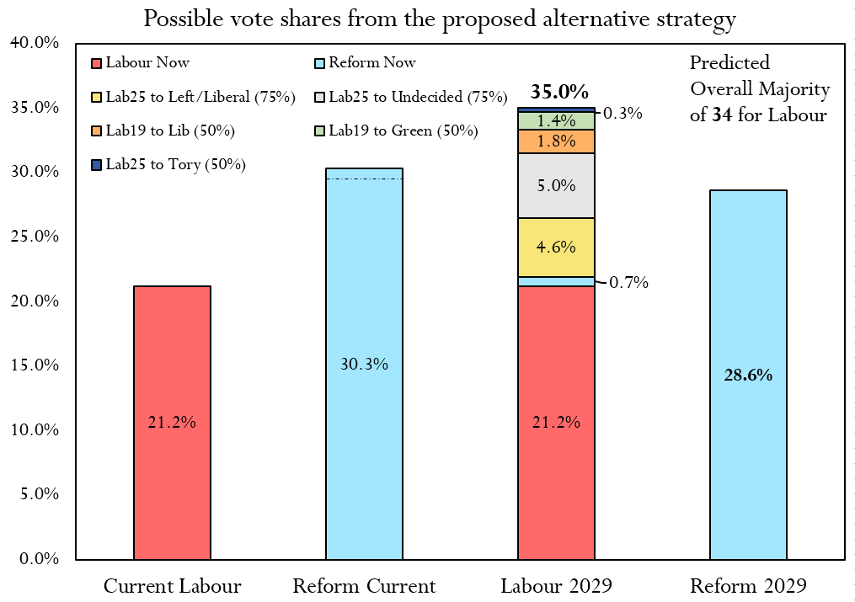
Reform can be beaten without taking a single vote from Reform!
30% of lost Reform voters that prioritise the economy
Remember losses to Reform only = 2.7% of all voters, losses elsewhere are much more numerous!
Labour can overtake Reform by building a coalition of progressive voters. They have secured the support of all of these voters at some point in the 5 years.

Slide 32
END

